Slide 1
Database Tuning Advisor for Microsoft SQL Server 2005
Presented by Balaji Ganesan
December 5, 2005

Slide 2
Overview
Integrated Physical Database Design
Performance vs. Manageability
Scalability
  Workload Compression
  Reduced Statistics Creation
  Exploiting test server to reduce load on production server

Slide 3
Database Tuning Advisor
Inputs
Databases
Workload
Features
Alignment Option
Partial Configuration
Storage Constraint
Time Constraint
Output
Configuration
  Indexes
  Materialized views
  Horizontal range partitioning

Slide 4
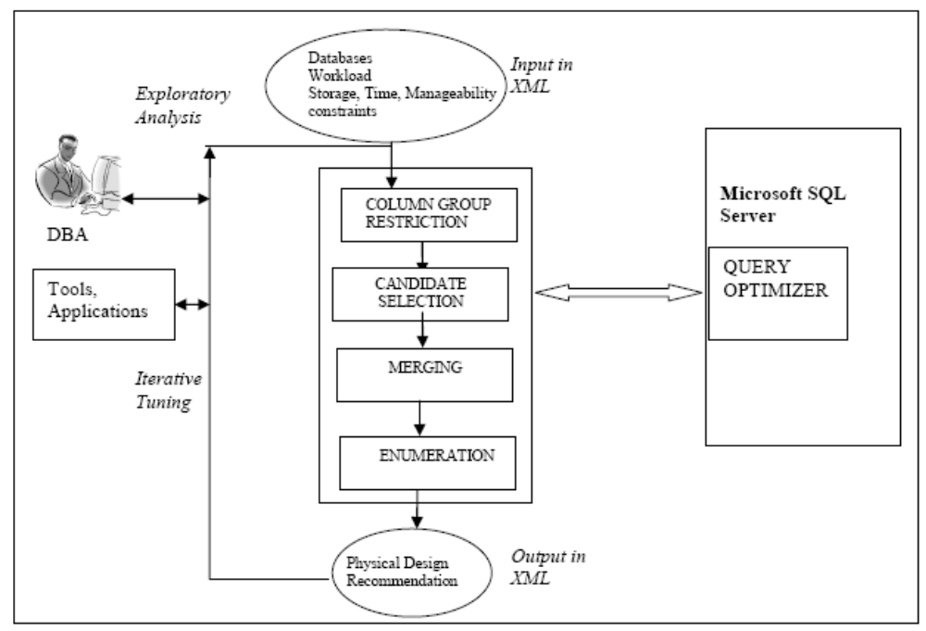
Architecture

Slide 5
Architecture
DTA’ Cost model:
  ‘What-if’ analysis interface
  For a query Q and configuration C DTA Can obtain the query optimizer estimated cost of Q.
  Recommends the configuration with the lowest estimated cost for the workload.

Slide 6
Architecture
Column Group Restriction
  The space of the all the physical design structures can be very large
  We can consider only “interesting columns” for the given workload.

Slide 7
Architecture
Candidate Selection
  Candidate: A physical design structure, that is part of the selected configurations for one or more queries.
  Uses Greedy (m,k) algorithm for selecting the candidate

Slide 8
Architecture
Merging
  Candidate selection operates at the level of an individual query.
  Considering only few such candidates may lead to “over-specialized” physical design.
  Merging produces more physical design features that can benefit multiple queries in the workload.

Slide 9
Architecture
Enumeration
  Chooses the physical database design from the union of all the candidates (including those from merging).
  Incorporating the alignment constraint can make this task unscalable.
  Candidates for the alignment constraint are introduced lazily.

Slide 10
Integrated Physical Design
Recommendations
SELECT A, COUNT(*) FROM T WHERE X < 10 GROUP BY A
Possible Physical Design Features:
A clustered index on (X), (A)
Table partitioned on (X), (A)
‘Covering’ index on (X,A)
A Materialized View

Slide 11
Staging vs. Integrated
Lets us consider the features clustered index and horizontal partioning.
If we use staging – index and then partioning
  Clustered index on A is likely to be more beneficial than horizontal partitioning on A
  Both work fine for X.
  Optimal solution clustered index on A and horizontal partition on X cannot be obtained.

Slide 12
Aligned Partitioning
  Aligned – A table and all of its indexes are partitioned identically.
  Need for Alignment:
    Ex: Horizontal range partitioning improves manageability but degrades performance.
  Alignment constraint restricts the search space for the physical design candidates.
  Lazy application of Alignment constraint.

Slide 13
Improved Scalability
Workload Compression
Reduced Statistics Creation
Exploiting test server to reduce load on production server

Slide 14
Workload Compression
Working on a subset of the workload to improve scalability
Two approaches:
  Sampling the workload at random intervals may end up tuning more queries than necessary.
  Tuning the top k queries by cost may end up tuning disproportionate number of queries from one ‘template’.

Slide 15
Workload Compression
Exploit the inherent templatization in workloads
Partition the workload based on the ‘signature’ of each query.
Pick a subset from each partition using a clustering based method.

Slide 16
Reduced Statistics Creation
Creating statistics is expensive
  Ex: Statistics on Indexes for ‘what-if’ analysis
To create a statistic on columns (A,B,C), SQL server generates a histogram on the leading column and computes ‘density’ information for each leading prefix. (A), (A,B), (A,B,C)

Slide 17
Reduced Statistics Creation
Example:
Suppose we need to consider indexes on columns (A), (B), (A,B), (B,A) and (A,B,C)
Naïve approach will create statistics for all the five indexes
However it is enough if we create statistics on (A,B,C) and (B)

Slide 18
Reduced Statistics Creation
DTA Approach
  Step 1: Create H-List {(A), (B)} and D-List {(A), (B), (A,B), (A,B,C)}
  Step 2: Pick the statistic (s) that covers as many elements of H and D Lists as possible. Here it is (A,B,C).
  Step 3: Remove all the elements from H and D that were covered by s in step 2. i.e (A) from H-List and (A), (B), (A,B) , (B,A) and (A,B,C)
  Step 4: Repeat 2 and 3 until H and D are empty.

Slide 19
Production/Test Servers
General Approach:
  Step 1: Copy the databases from the production server to test server
  Step 2: Tune the workload on the test server
  Step 3: Apply the recommendation obtained from the test server to the production server

Slide 20
Production/Test Servers
DTA Approach:
  Step 1: Copy the metadata of the databases from the production to the test server
  Step 2: Tune the workload on the test server
    Import statistics from the production server
    Simulate the hardware parameters of the production server
  Step 3: Apply the recommendation obtained from the test server to the production server

Slide 21
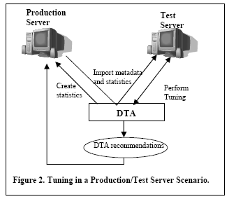
Production/Test Servers

Slide 22
Enhanced Usability
Scriptability
  XML Schema Input/Output
User Specified Configuration
  Partial Specification by DBA
Exploratory Analysis
  ‘What-if’ physical design analysis
Iterative Tuning

Slide 23
Experiments
Workload | Quality of hand tuned design | Quality of DTA | Number of Events tuned | Tuning timing (hr:min)
CUST1 | 82% | 87% | 15K | 0:35
CUST2 | 6% | 41% | 252K | 8:21
CUST3 | -5% | 0% | 176K | 15:14
CUST4 | 0% | 50% | 9K | 1:07

Slide 24
Contributions
Integrated Physical Database design
Ability to specify alignment constraint and partially specified configuration
An XML Schema for Input/output

Slide 25
Database Tuning Advisor for Microsoft SQL Server 2005
Presented by Balaji Ganesan
December 5, 2005

